Slide 1
Applied Probability I
Dr. Bahman Honari
Autumn 2020

Slide 2
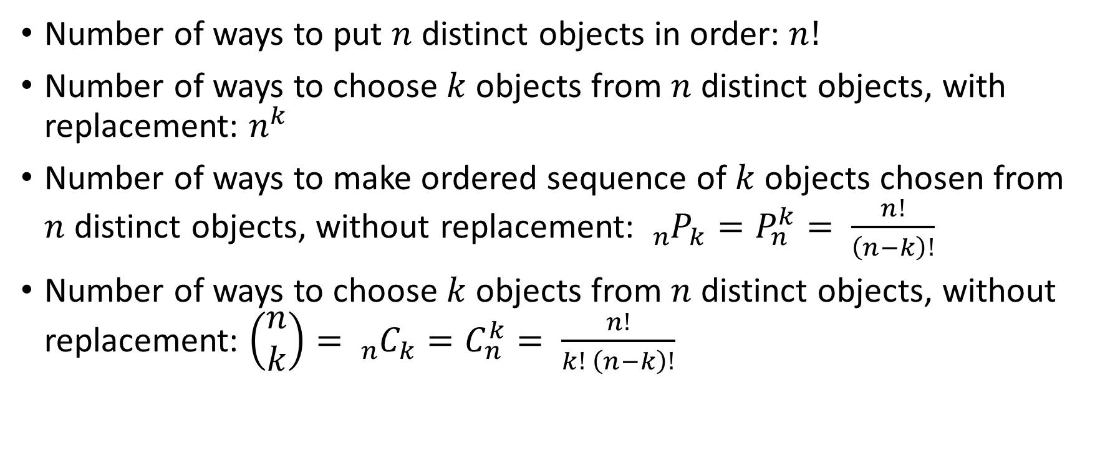
Rules for Counting - Summary
Number of ways to put $n$ distinct objects in order: $n!$
Number of ways to choose $k$ objects from $n$ distinct objects, with replacement: $n^{k}$
Number of ways to make ordered sequence of $k$ objects chosen from $n$ distinct objects, without replacement: ${}_{n}^{}{P_{k}}=P_{n}^{k}= \frac{n!}{\left(n−k\right)!}$
Number of ways to choose $k$ objects from $n$ distinct objects, without replacement: $\left(\begin{matrix}n \\ k\end{matrix}\right)={}_{n}^{}{C_{k}}=C_{n}^{k}= \frac{n!}{k! \left(n−k\right)!}$

Slide 3
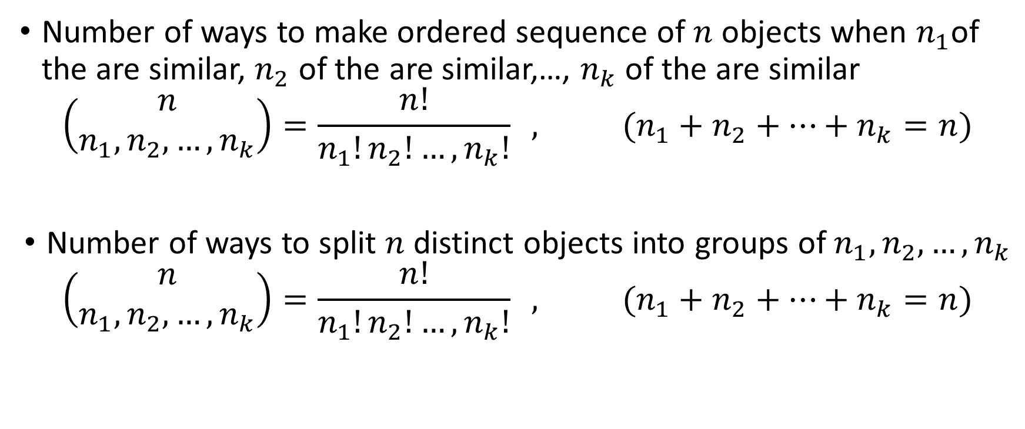
Rules for Counting - Summary
Number of ways to make ordered sequence of $n$ objects when $n_{1}$of the are similar, $n_{2}$ of the are similar,…, $n_{k}$ of the are similar
$$\left(\begin{matrix}n \\ n_{1},n_{2},…,n_{k}\end{matrix}\right)=\frac{n!}{n_{1}!n_{2}!…,n_{k}!} , (n_{1}+n_{2}+…+n_{k}=n)$$
Number of ways to split $n$ distinct objects into groups of $n_{1},n_{2},…,n_{k}$
$$\left(\begin{matrix}n \\ n_{1},n_{2},…,n_{k}\end{matrix}\right)=\frac{n!}{n_{1}!n_{2}!…,n_{k}!} , (n_{1}+n_{2}+…+n_{k}=n)$$

Slide 4

Rules for Counting - Summary
Number of ways to split $n$ similar objects into groups of $n_{1},n_{2},…,n_{k}$
$$\left(\begin{matrix}n+k−1 \\ k−1\end{matrix}\right)={}_{n+k−1}^{}{C_{k−1}}=C_{n+k−1}^{k−1}$$

Slide 5

Rules for Counting - Summary
Number of ways to split $n$ similar objects into groups of $n_{1},n_{2},…,n_{k}$ where ${0 ≤n}_{1}≤m$ equals
$$\sum_{s=0}^{k}{{(−1)}^{s}}\left(\begin{matrix}k \\ s\end{matrix}\right)\left(\begin{matrix}n+k−\left(m+1\right)s−1 \\ k−1\end{matrix}\right)$$

Slide 6
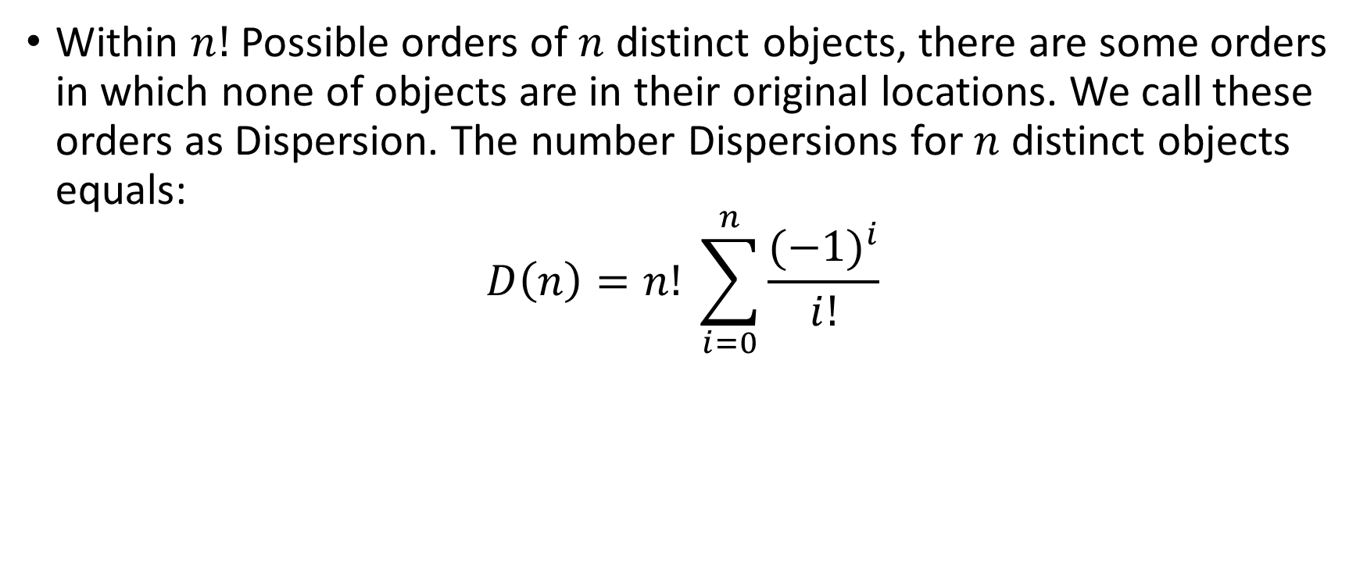
Rules for Counting - Summary
Within $n!$ Possible orders of $n$ distinct objects, there are some orders in which none of objects are in their original locations. We call these orders as Dispersion. The number Dispersions for $n$ distinct objects equals:
$$D\left(n\right)=n! \sum_{i=0}^{n}{\frac{{(−1)}^{i}}{i!}}$$

